Slide 1

HR Attrition Analysis
Tool: Power BI
Dataset: HR Employee Attrition
Created By: Devansh Chauhan
This Photo by Unknown Author is licensed under CC BY-NC-ND

Slide 2

Executive Summary
Key Metrics
Total Employees: 1,470
Attrition Count: 237
Attrition Rate: 16.1%
Average Age: 36.9 Years
Average Monthly Income: ₹6.5k
Objective
Identify the major factors influencing employee attrition and provide recommendations to improve retention.

Slide 3
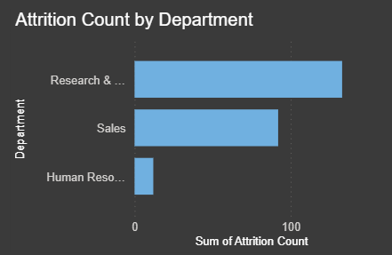
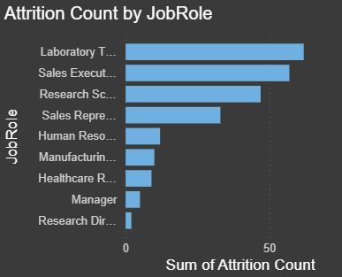
Department And Job Role Analysis
Insights
Research and Development department recorded the highest attrition.
Young Adult and experienced groups showed comparatively lower attrition.
Laboratory Technicians experienced the highest attrition among all job roles.
Sales Executives and Research Scientists also showed elevated turnover

Slide 4
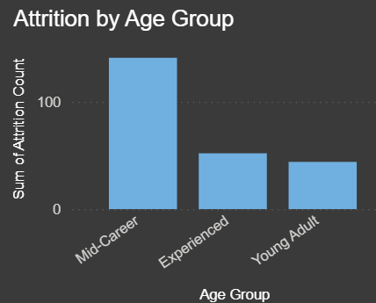
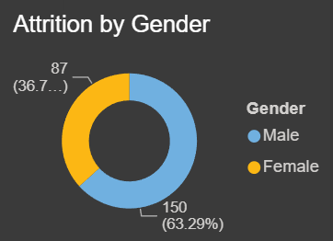
Demographic Analysis
Insights
Mid-career employees contributed the highest number of attrition cases.
Sales department has the second highest attrition.
Male employees accounted for approximately 63% of total attrition.
Female employees accounted for approximately 37%.

Slide 5
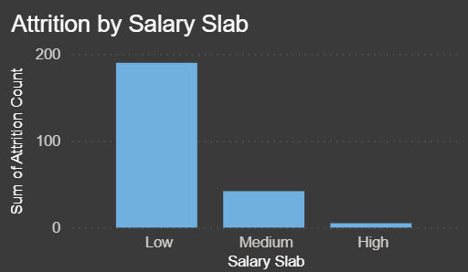
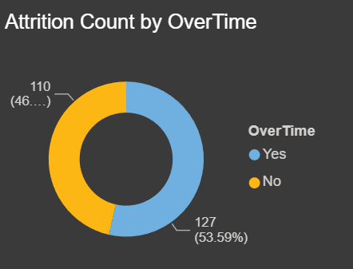
Salary And Overtime Analysis
Insights
Employees in the Low salary category experienced significantly higher attrition
Medium and High Salary groups showed much lower turnover.
Employees working overtime represented majority of attrition cases.
Overtime appears to be strongly associated with employee turnover.

Slide 6
Recommendations
Improve Compensation Strategy
Review Salary structures for lower-income employees and introduce retention incentives.
Strengthen Career Growth Programs
Provide clear promotion paths and skill development opportunities for mid-career employees.
Reduce Overtime Dependency
Balance workloads and optimize staffing to prevent burnout.
Focus on High Risk-Roles
Implement retention programs for laboratory Technicians, Sales Executives, and Research Scientists.

